Slide 1
NYC Sustainable Buildings
Module 1
CUNY Institute for Urban Systems
Building Performance Lab
NOTE: This was created specifically for NYC. Please update the laws and numbers for your city.
For matriculated students of the City College of New York
Supported by NYSERDA’s REV Campus Challenge

Slide 2
Learning Objectives
At the end of this lesson students will be able to:
describe the major state and city laws codes regarding building energy usage and carbon emissions
describe the intent and methods of the LL97 of 2019 carbon emission limits and penalties
review the major systems that contribute to building energy usage and do an example calculation for a space heating load
Notes:
Say: Review the module objectives

Slide 3
New York’s Energy Policies

Slide 4

New York State
2019 Energy Plan
by 2030:
  limit GHG to 40% of 1990 levels
  have 70% renewable electricity
by 2040:
  have 100% zero emission electricity
by 2050:
  limit GHG to 85% of 1990 levels
Source: https://www.dec.ny.gov/energy/99223.html

Slide 5
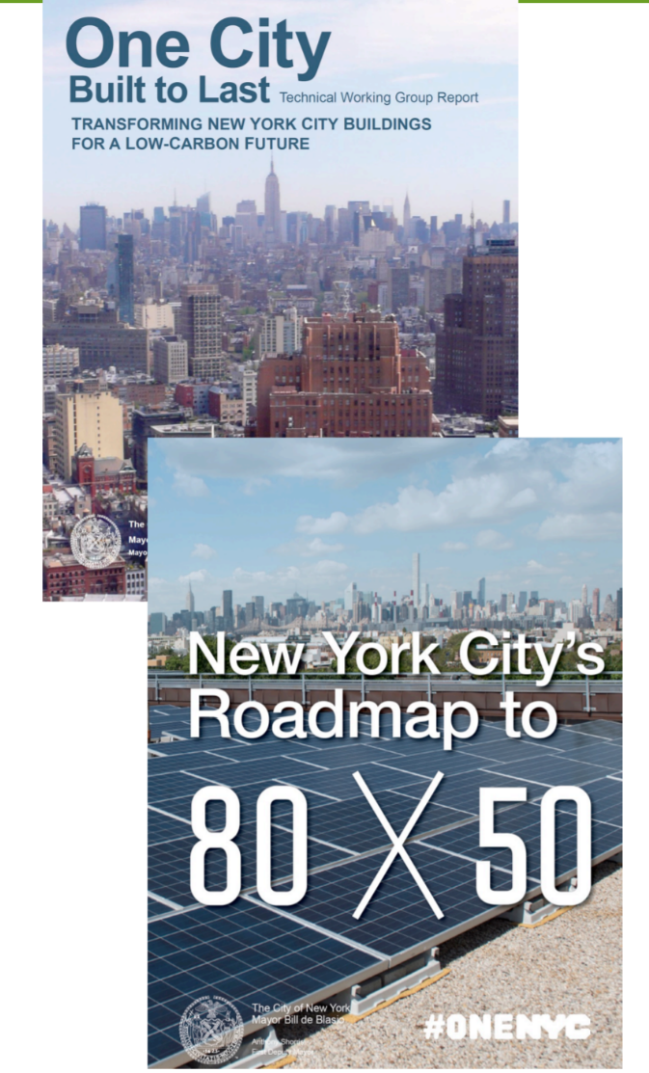
New York City
Progression of Energy Laws
2007 - PlaNYC
  “20 x 30” energy goal
2009 - Greener, Greater Buildings Plan
  Local Law 84 - Benchmarking
  Local Law 87 - Energy Audits, Retro-commissioning
2014 - One City, Built to Last
  “80 x 50” GHG reduction goal
2015 - GHG Inventory
  66% due to energy in buildings
2019 - Climate Mobilization Act
  Local Law 95 - Letter Grades
  Local Law 97 - GHG Limit, Penalties

Slide 6
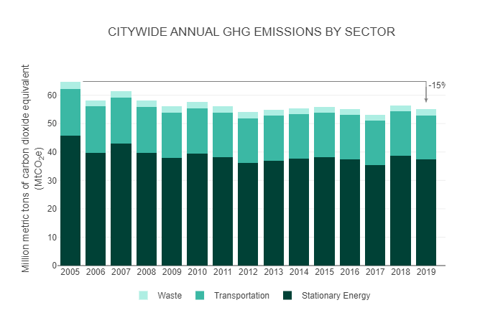
Why Buildings?
40% reduction by Jul ‘24
50% reduction by Jan ‘30
Source: https://nyc-ghg-inventory.cusp.nyu.edu/

Slide 7
Building Energy Standards
Building codes give the minimum “livable” requirements for new construction/renovations, with energy code being a relatively new addition. The different levels are:
“Up to code” - the minimum for legal occupancy
Stretch code - a “test case” for future code that may reduce energy consumption from 15% to 30%
  Performance code - a type of stretch code that is based on actual measured energy performance
High performance buildings - above and beyond code
  Passive house, EnerFit, ZEH, Living Challenge
Notes:
Explain that Pacific Northwest National Lab (PNNL) conducted an extensive application of BRT, together with measurement and verification.
Emphasize the potential savings, and that these savings are based on applying BRT measures to the majority of building systems.

Slide 8
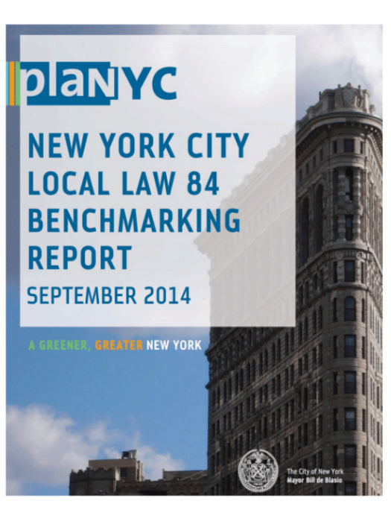
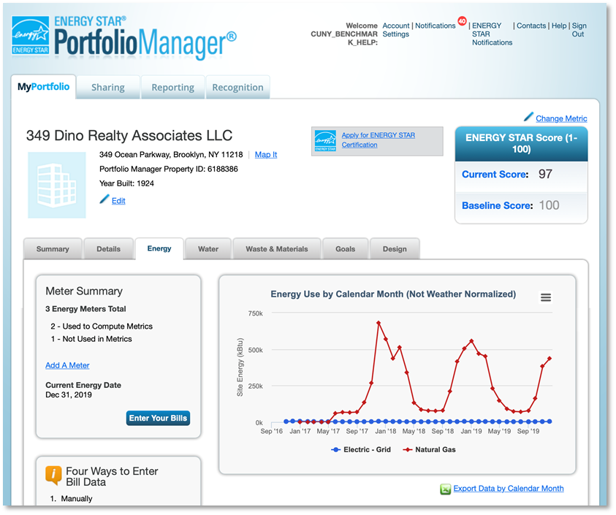
Benchmarking
LL84 of 2009, LL133 of 2016
Collect and report a building’s energy and water consumption throughout the year with ENERGY STAR Portfolio Manager®.
  annual energy use is reported in EUI = Energy Use Intensity (BTU/SF), normalized by weather
File a benchmarking report by May 1st annually.
Benchmarking now applies to buildings over 25,000 square feet.

Slide 9

Energy Audits & Retro-Commissioning
LL87 of 2009
Once every 10 years:
  Have an energy audit conducted to inform owners of potential energy efficiency projects and the economics for each project
  Have base building systems tested (retro-commissioning) to ensure they are working efficiently and tune them if not
Ongoing commissioning - regular, voluntary use of the commissioning process to maintain low-energy use in buildings throughout its operational life

Slide 10
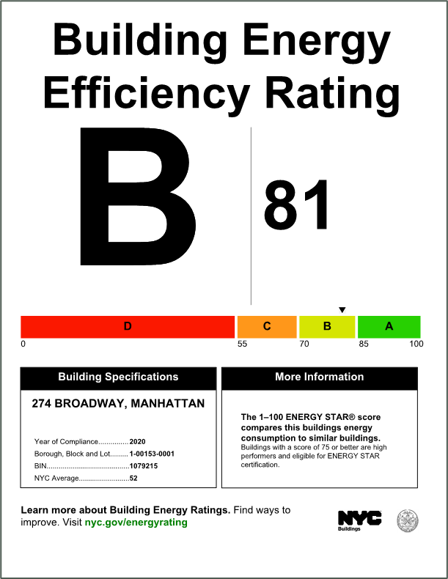
Building “Letter Grades” + GHG Limits
LL33 of 2018, LL95 of 2019
Post energy efficiency grade near each public entrance and update the sign annually by the end of October.
Grades are related to benchmarking report
LL97 of 2019
Requires owners to demonstrate compliance with Greenhouse Gas (GHG) emissions limits, beginning in 2024 and becoming more stringent in 2030.
Stay under the limit or pay what can be a significant annual penalty.

Slide 11
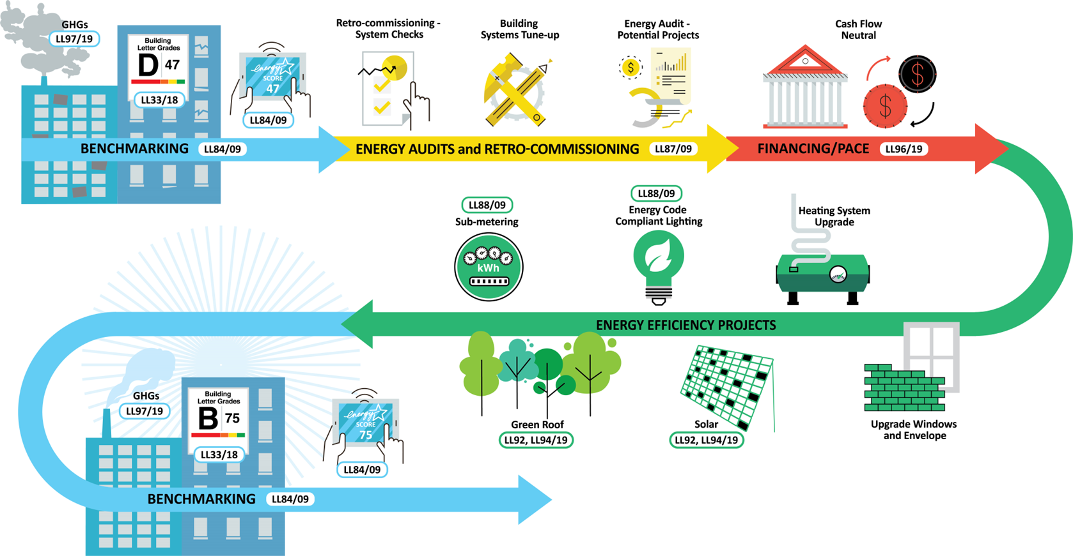
How The Laws Fit Together

Slide 12
Deeper Dive into LL97

Slide 13
Local Law 97 - Goals
According to nyc.gov, “Local Law 97 is one of the most ambitious plans for reducing emissions in the nation.”
Goals:
40% reduction in GHG emissions by 2030
80% reduction in GHG emissions by 2050
with a 2023 rule, GHG emissions are reduced to zero by 2050
Buildings covered:
buildings larger than 25,000 sq. ft.
additional rules apply to address multiple buildings on a lot, etc.
Notes:
relative to 2005 data

Slide 14
Local Law 97 - GHG Limits
GHG emissions limits were set up in the original law but recently DOB has amended them to be based on Energy Star Portfolio Manager (ESPM) Property Types.
This makes the limits more fair and equitable as each property type will have different baseline levels of GHG emissions. For example, a 24/7 hospital should have a higher baseline than a school which closes on nights and weekends. This makes sure that the penalties are based only on comparing like buildings.

Slide 15
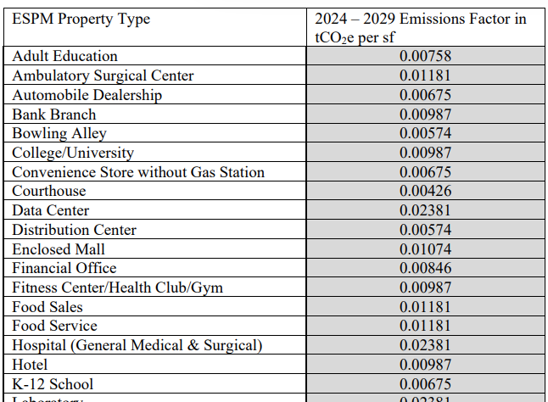
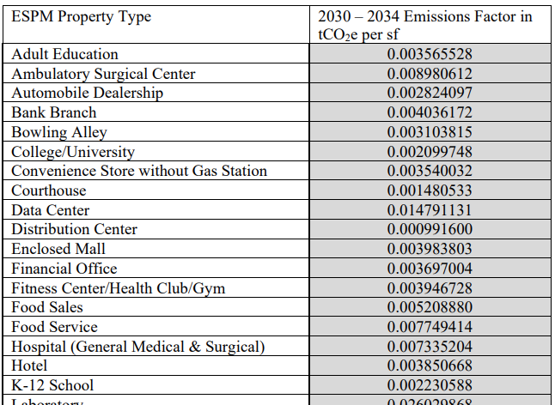
Local Law 97 - GHG Limits
There are two sets of limits, one for 2024-2029 and another for beyond 2029. The first compliance reports are due 5/1/2025.
2024-2029 Limits Beyond 2029 Limits

Slide 16
Local Law 97 - Exercise
The annual penalty for exceeding the annual building emissions limit is up to $268 per ton of emissions over the limit.
Let’s use a calculator on two examples:
MF residential building, energy from electricity and #4 fuel oil
Mixed-use building – MF residential, retail, and a medical office, energy from gas and electricity
The data come directly from benchmarking submissions.
Calculator is available at: www.be-exchange.org/calculator/

Slide 17
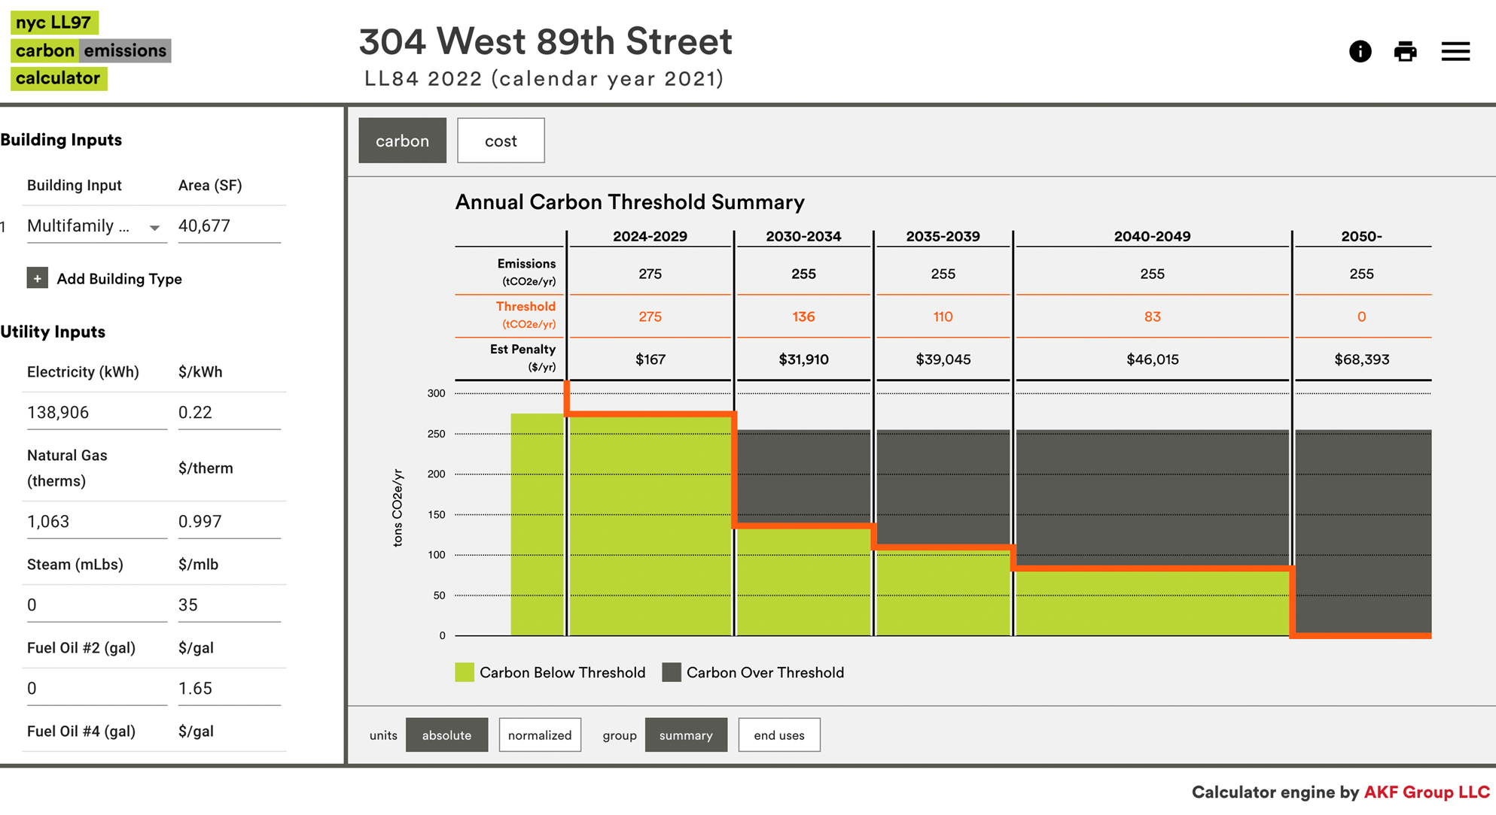
Local Law 97 - Example 1

Slide 18
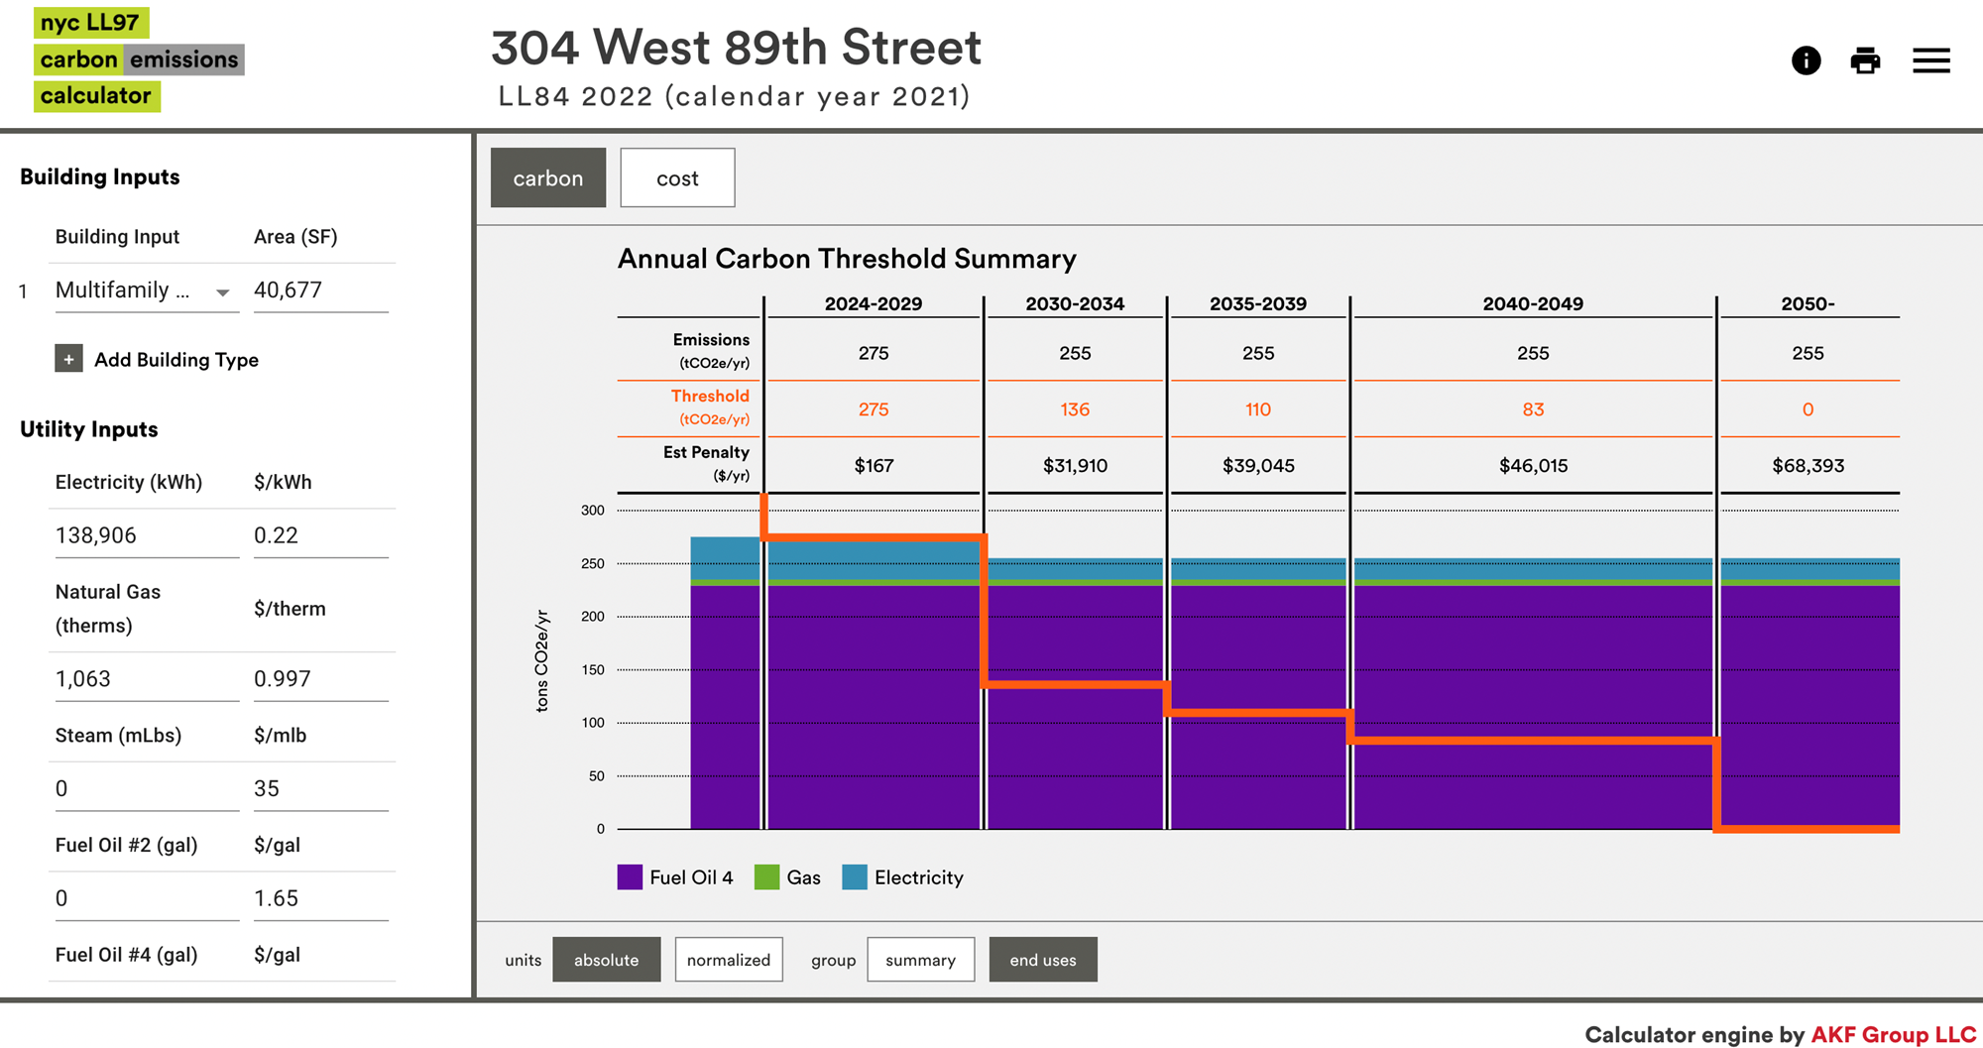
Local Law 97 - Example 1

Slide 19
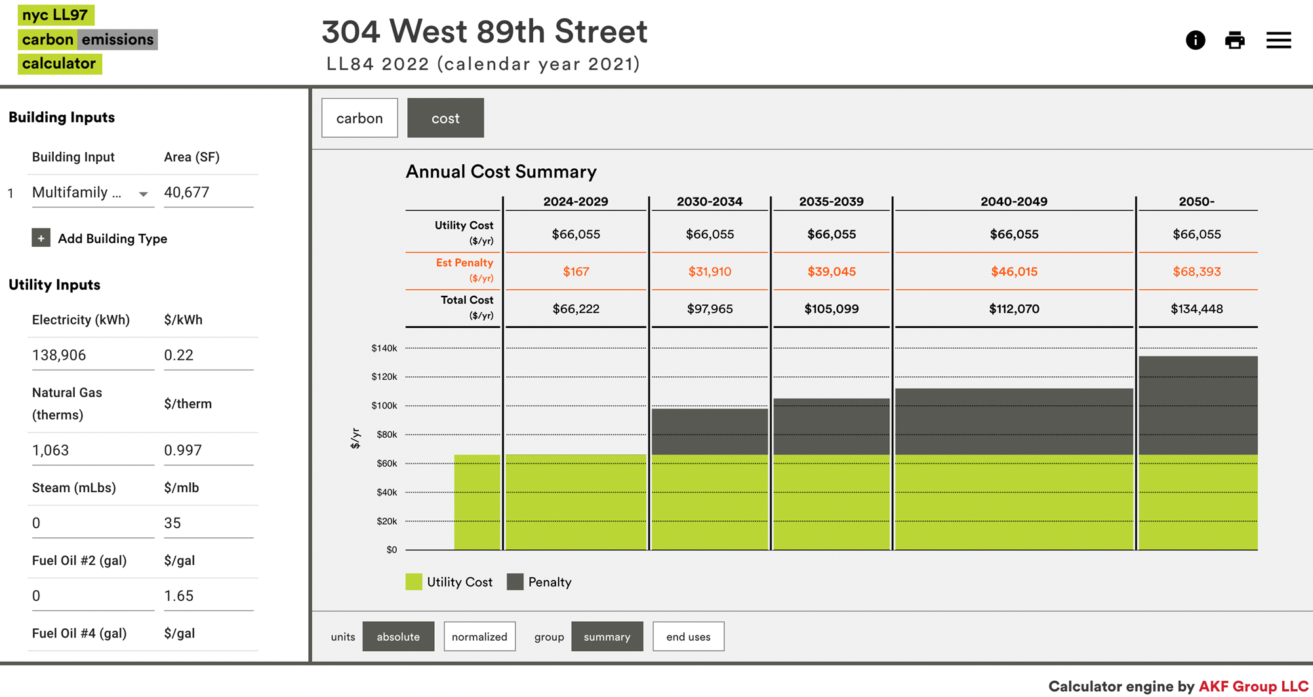
Local Law 97 - Example 1

Slide 20
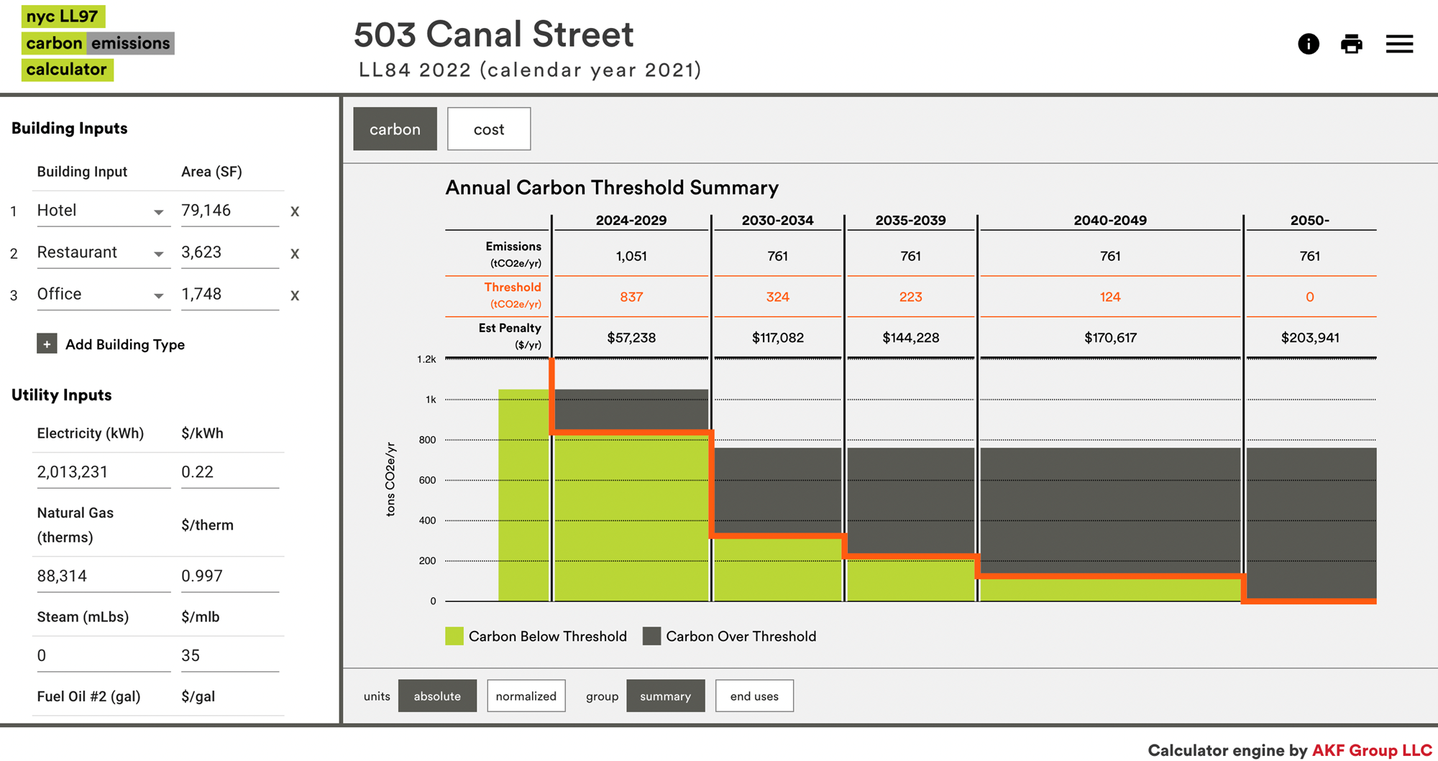
Local Law 97 - Example 2

Slide 21
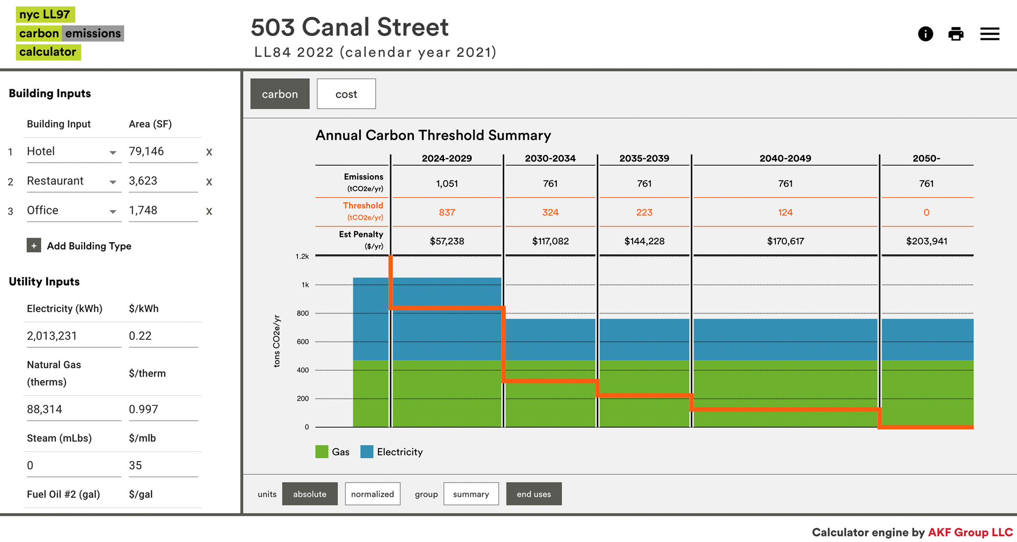
Local Law 97 - Example 2

Slide 22
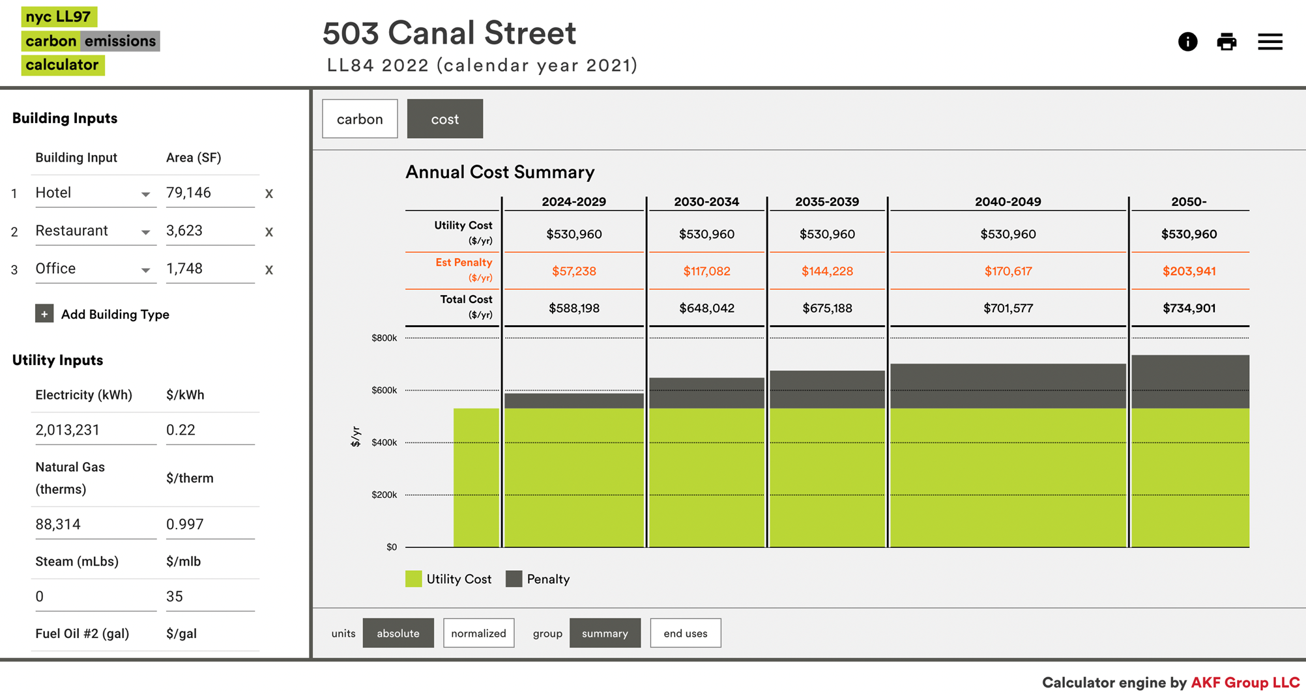
Local Law 97 - Example 2

Slide 23

Current data on LL97 Penalties
About 20% of buildings under the law currently exceed their 2024 GHG limits
About 75% of buildings under the law currently exceed their 2030 GHG limits
Penalties on owners can be severe, e.g., $1/sqft/yr

Slide 24
Options for Reducing GHGs
Improve Energy Efficiency
improved operations and maintenance; focused on better performance of building envelope, HVAC, DHW, lighting and controls
Reduce Carbon intensity
switch from oil to gas; add solar on your roof
Use Clean Distributed Energy Resources
using solar PV, battery storage, or thermal storage
Buy Renewable Energy Credits
Buy Carbon Offsets
Carbon Trading

Slide 25
In order to implement these options, we need to first understand how buildings use energy and how we can design and build them for high energy efficiency.
Notes:
Emphasize the criticality of students developing this skill, as it is central to identifying inefficiencies and determining what actions might be taken.

Slide 26
Building Science

Slide 27
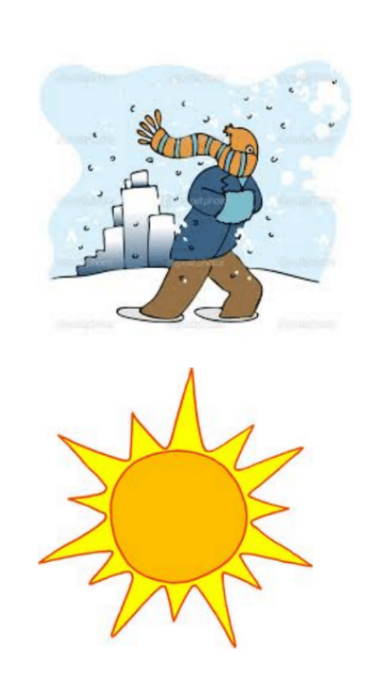
Building Envelope
What a building does/supposed to do
  Provide for occupant health, safety
  Provide for occupant comfort
      warm in winter, cool in summer
Envelope = boundary
  Between outdoor and indoor conditions
  Controls the amount of heat, air, moisture, light, sound that is inside the building
Notes:
Explain that Pacific Northwest National Lab (PNNL) conducted an extensive application of BRT, together with measurement and verification.
Emphasize the potential savings, and that these savings are based on applying BRT measures to the majority of building systems.

Slide 28
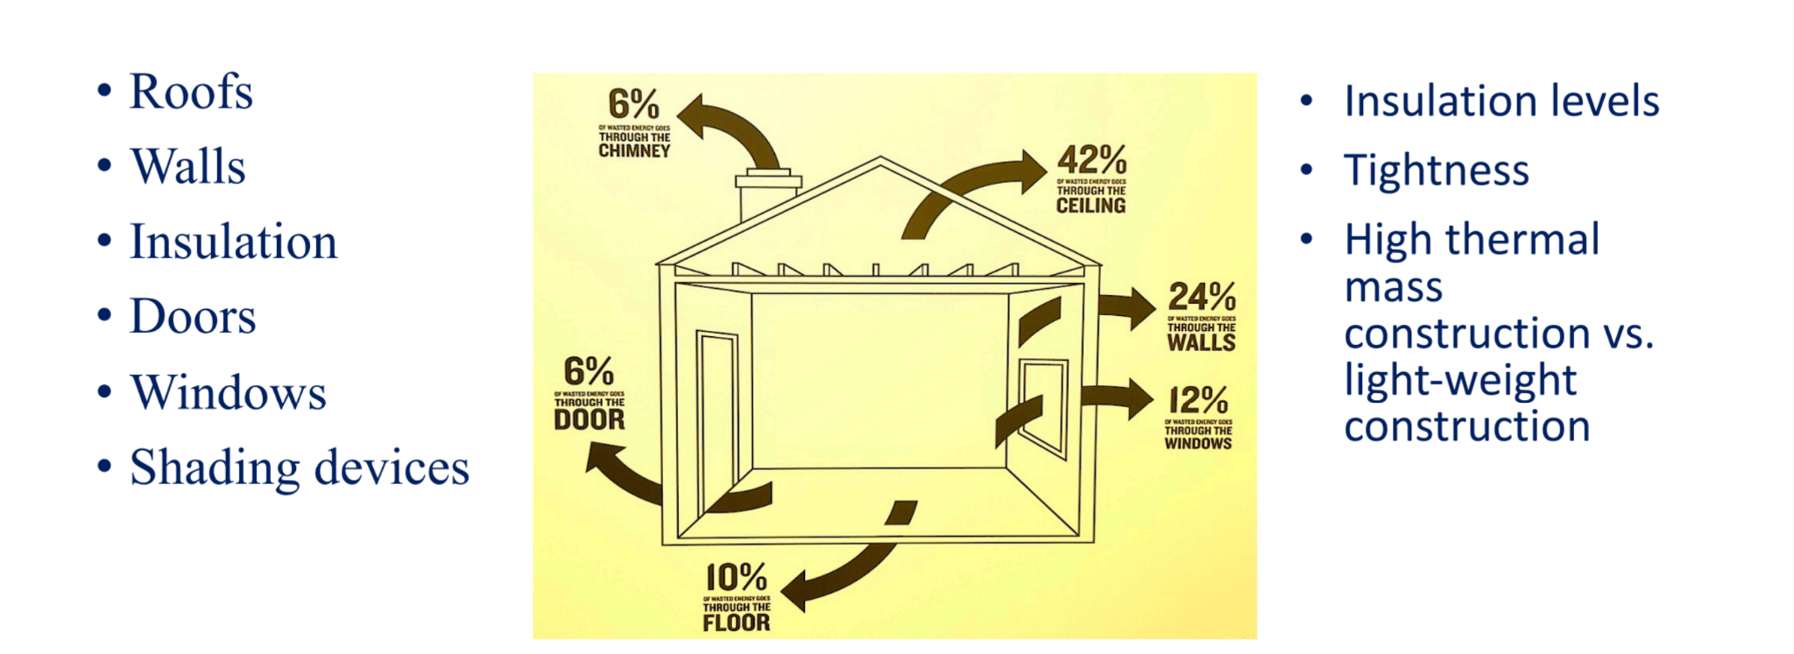
Envelope Components & Considerations
Notes:
Explain that Pacific Northwest National Lab (PNNL) conducted an extensive application of BRT, together with measurement and verification.
Emphasize the potential savings, and that these savings are based on applying BRT measures to the majority of building systems.

Slide 29
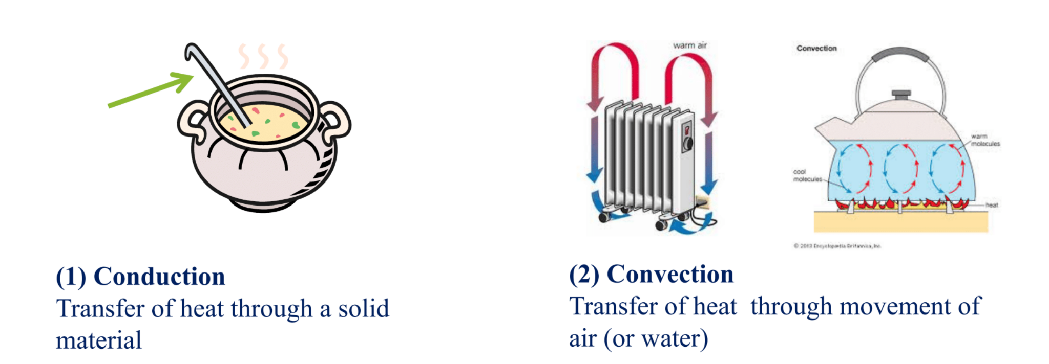
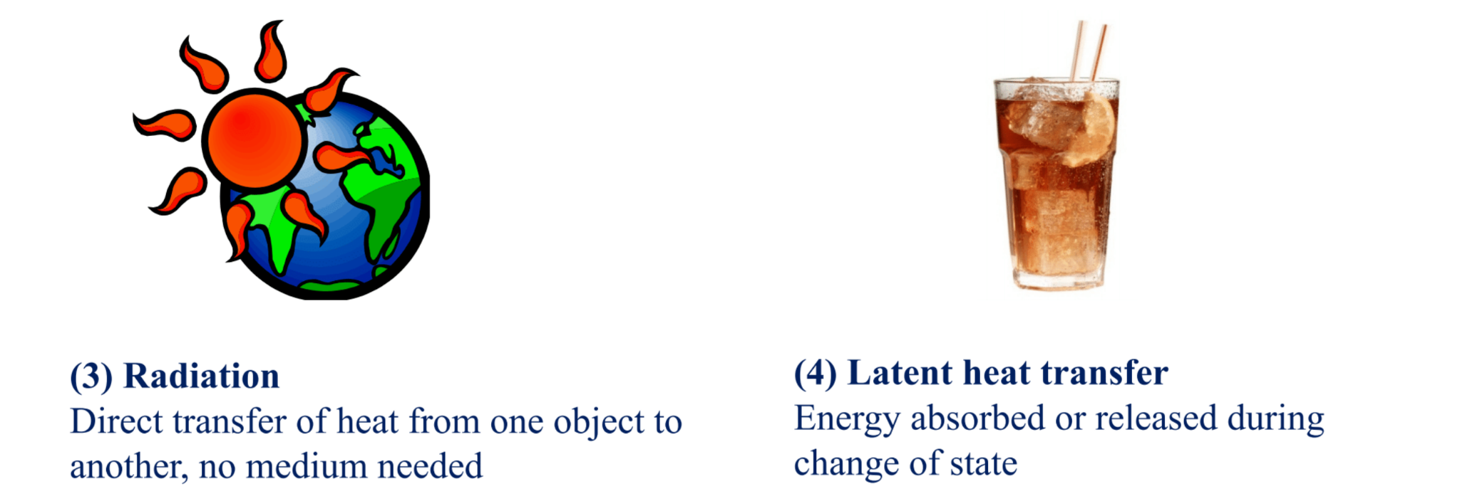
Thermodynamics
Notes:
Explain that Pacific Northwest National Lab (PNNL) conducted an extensive application of BRT, together with measurement and verification.
Emphasize the potential savings, and that these savings are based on applying BRT measures to the majority of building systems.

Slide 30
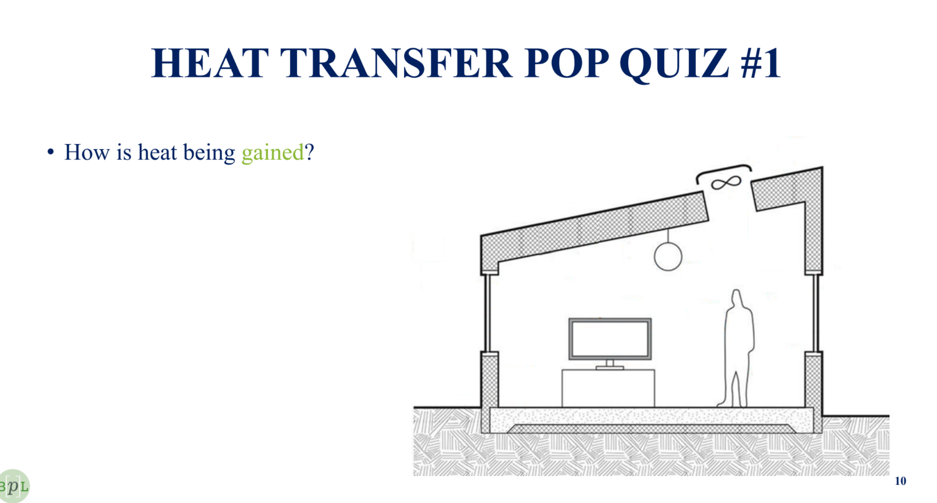
NOTE: The Outdoor Air Temp. is 80°F

Slide 31
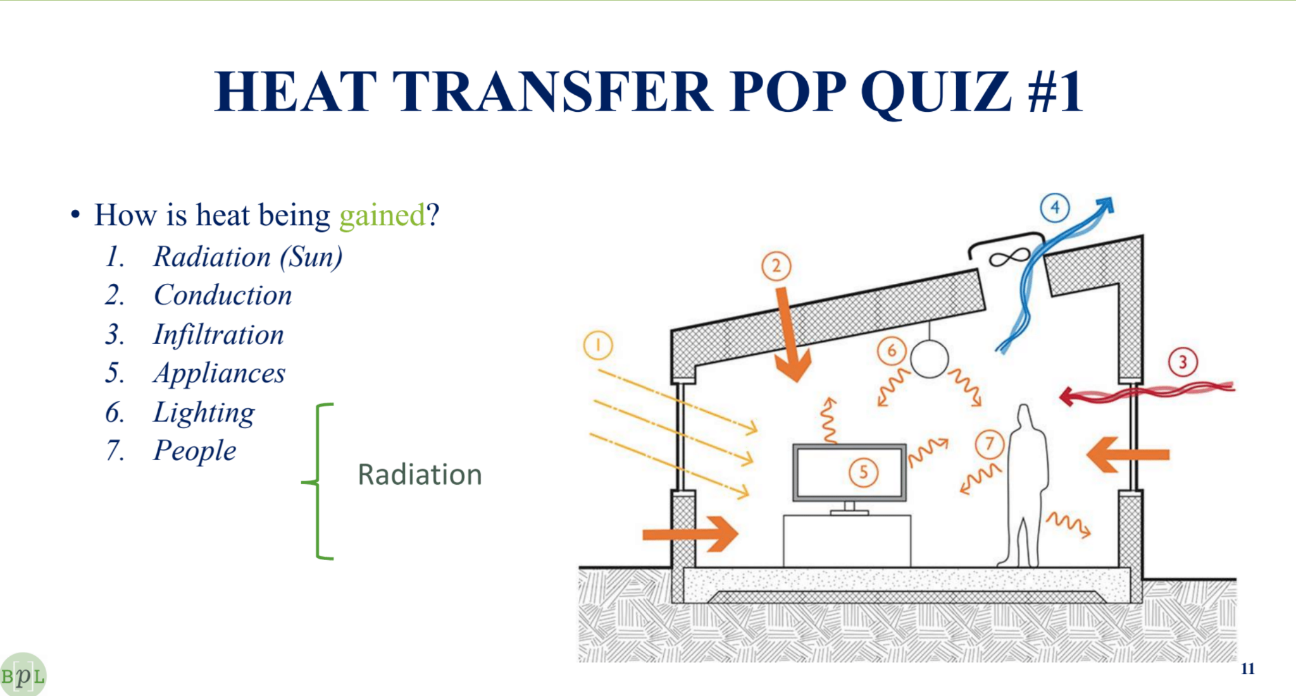

Slide 32
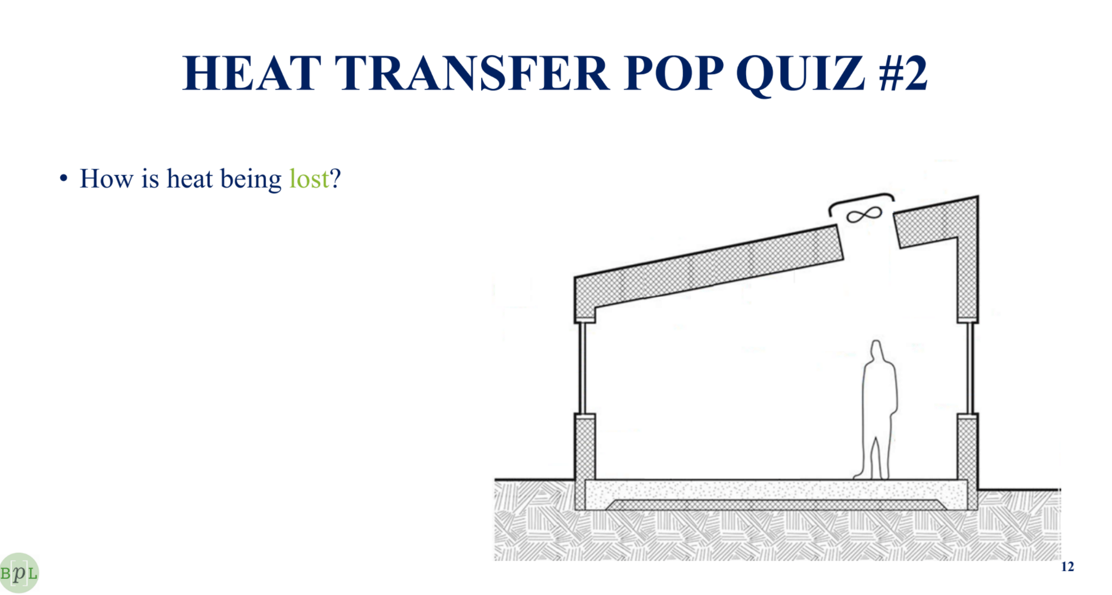
NOTE: The Outdoor Air Temp. is 40°F

Slide 33
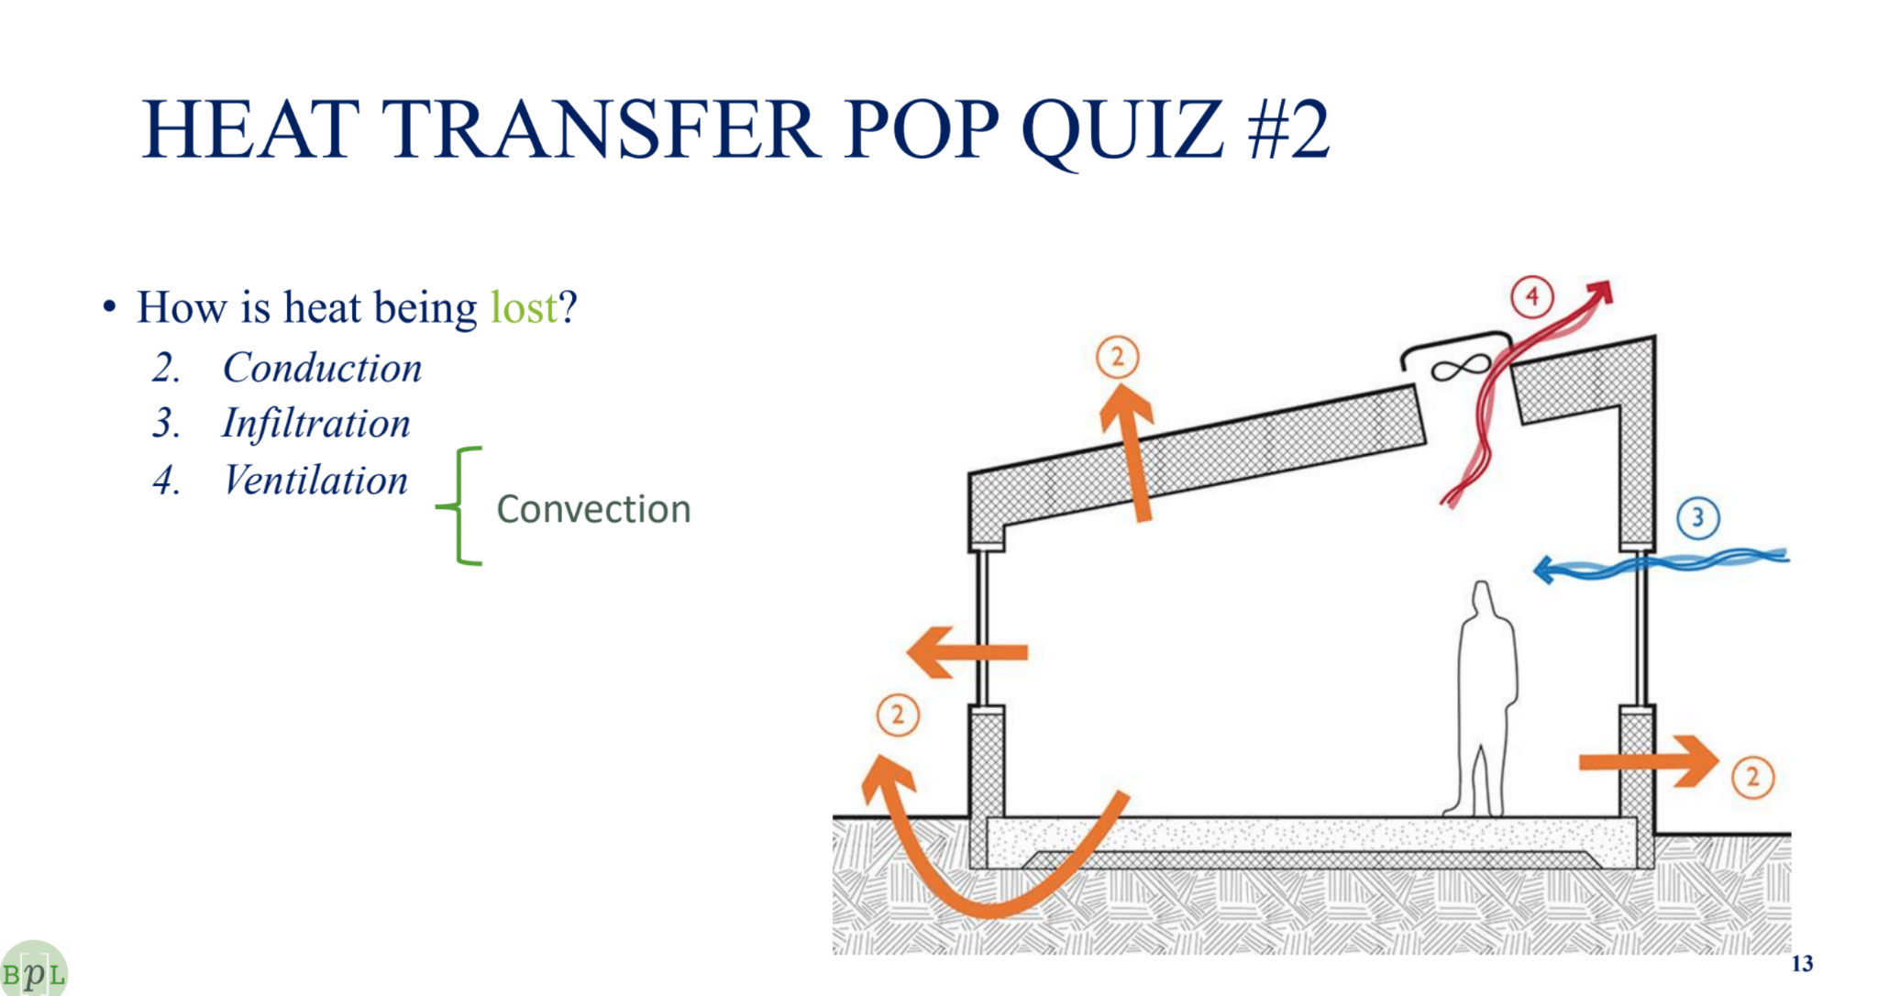

Slide 34
Building HVAC
Reminder of what a building does
  Provide for occupant health, safety
  Provide for occupant comfort
      warm in winter, cool in summer
HVAC = Heating, Ventilation, Air Conditioning
  mechanical equipment that ensures the right levels of fresh air, temperature, and/or humidity
Notes:
Explain that Pacific Northwest National Lab (PNNL) conducted an extensive application of BRT, together with measurement and verification.
Emphasize the potential savings, and that these savings are based on applying BRT measures to the majority of building systems.

Slide 35
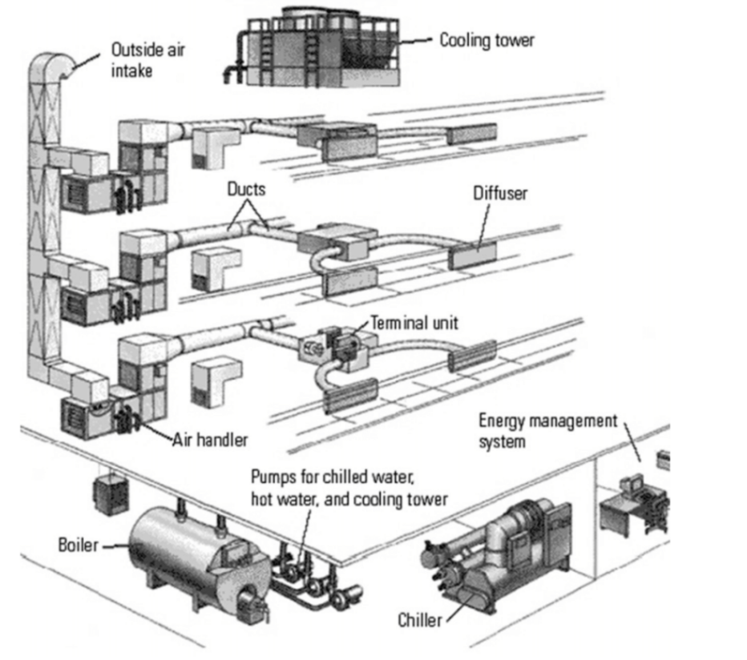
Major HVAC Equipment
Central Plant
  Boiler
  Chiller (+Cooling Tower)
Distribution
  Pumps and Fans
  Air-Handling Units
  Terminal Units
A Lightning Overview
Helpful Resource: https://youtu.be/1cvFlBLo4u0
Notes:
Explain that Pacific Northwest National Lab (PNNL) conducted an extensive application of BRT, together with measurement and verification.
Emphasize the potential savings, and that these savings are based on applying BRT measures to the majority of building systems.

Slide 36
Building Loads
“HEATING/COOLING LOAD”
  The total amount of heating/cooling that is needed to maintain a desired space temperature
  This load determines the design and sizing of the HVAC equipment
Notes:
Explain that Pacific Northwest National Lab (PNNL) conducted an extensive application of BRT, together with measurement and verification.
Emphasize the potential savings, and that these savings are based on applying BRT measures to the majority of building systems.

Slide 37
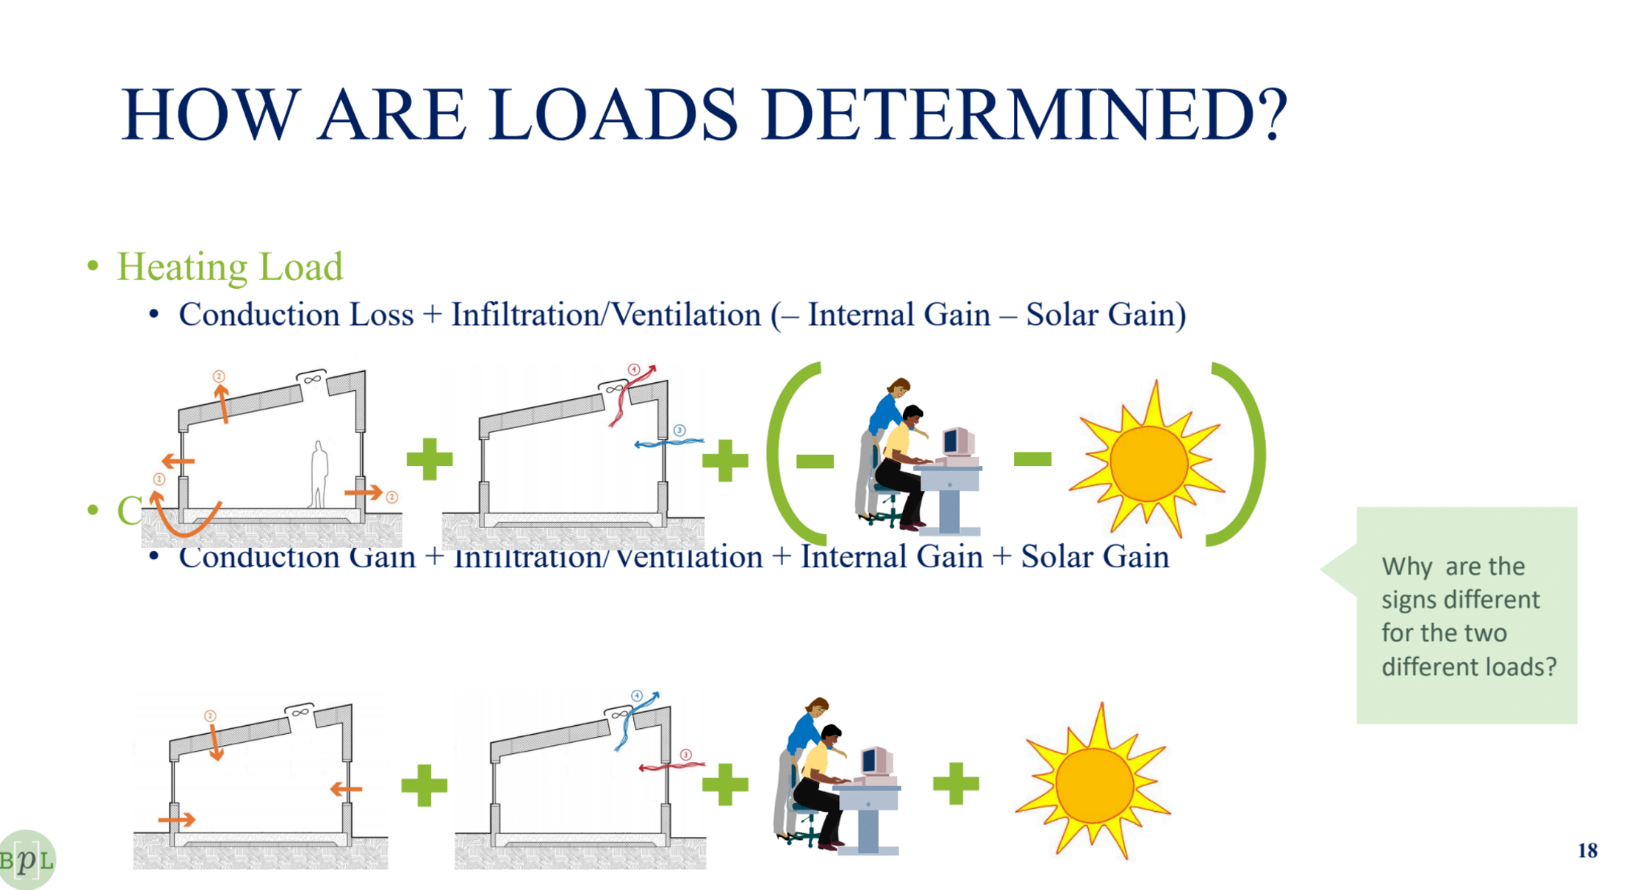
Calculating Loads
HEATING LOAD
  Conduction Loss + Infiltration/Ventilation + (- Internal Gain - Solar Gain)
COOLING LOAD
  Conduction Loss + Infiltration/Ventilation + Internal Gain + Solar Gain
Notes:
Explain that Pacific Northwest National Lab (PNNL) conducted an extensive application of BRT, together with measurement and verification.
Emphasize the potential savings, and that these savings are based on applying BRT measures to the majority of building systems.

Slide 38
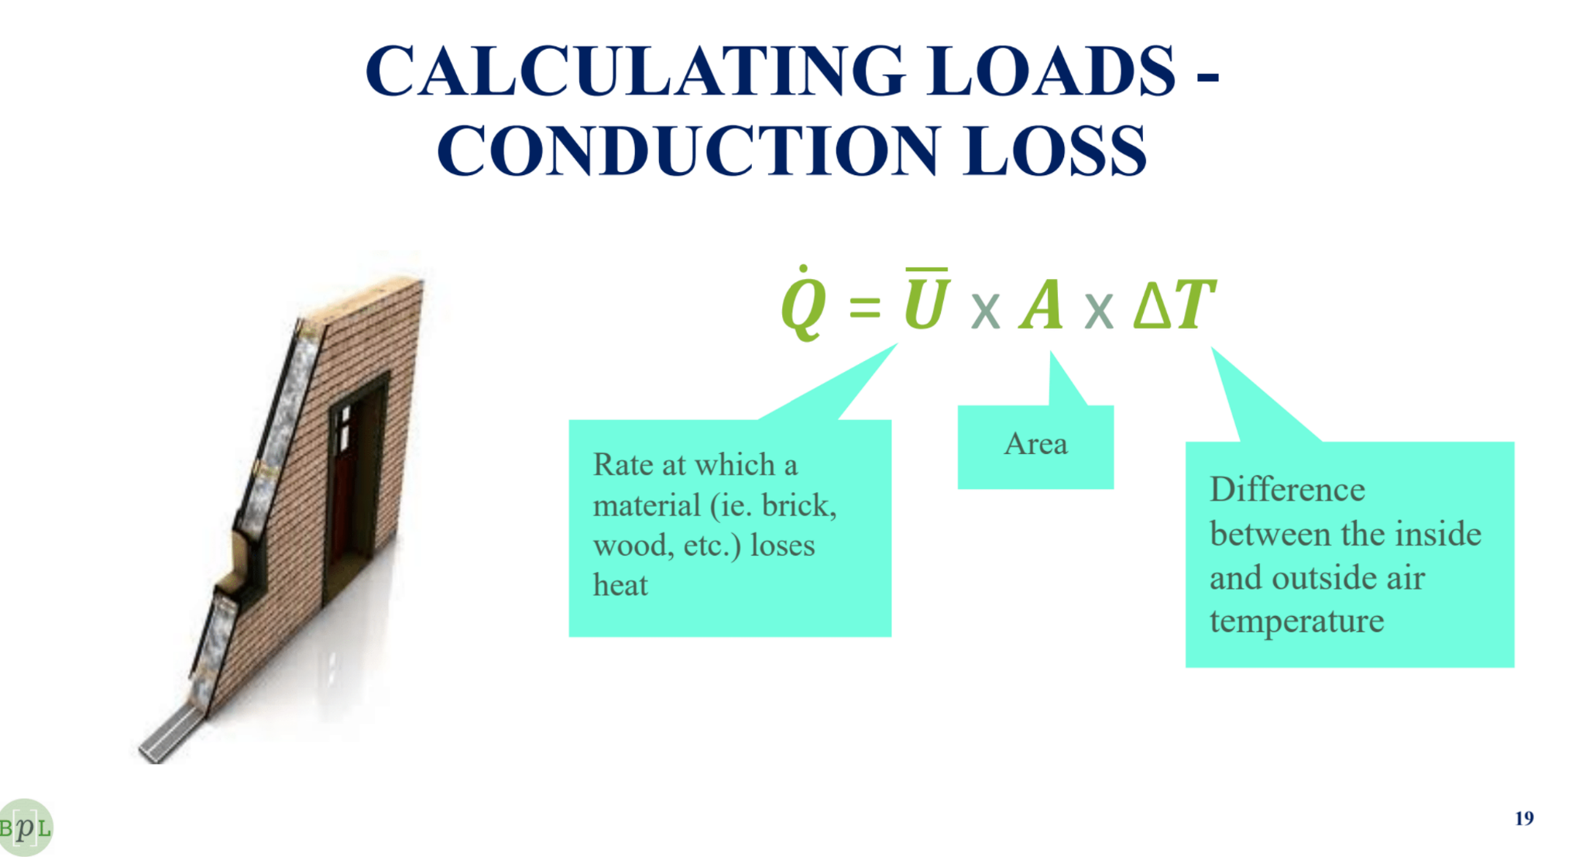
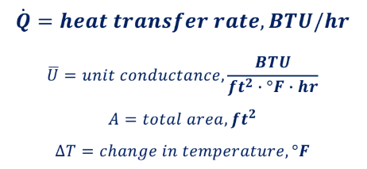
Calculating Loads - Conduction Loss
Notes:
Explain that Pacific Northwest National Lab (PNNL) conducted an extensive application of BRT, together with measurement and verification.
Emphasize the potential savings, and that these savings are based on applying BRT measures to the majority of building systems.

Slide 39
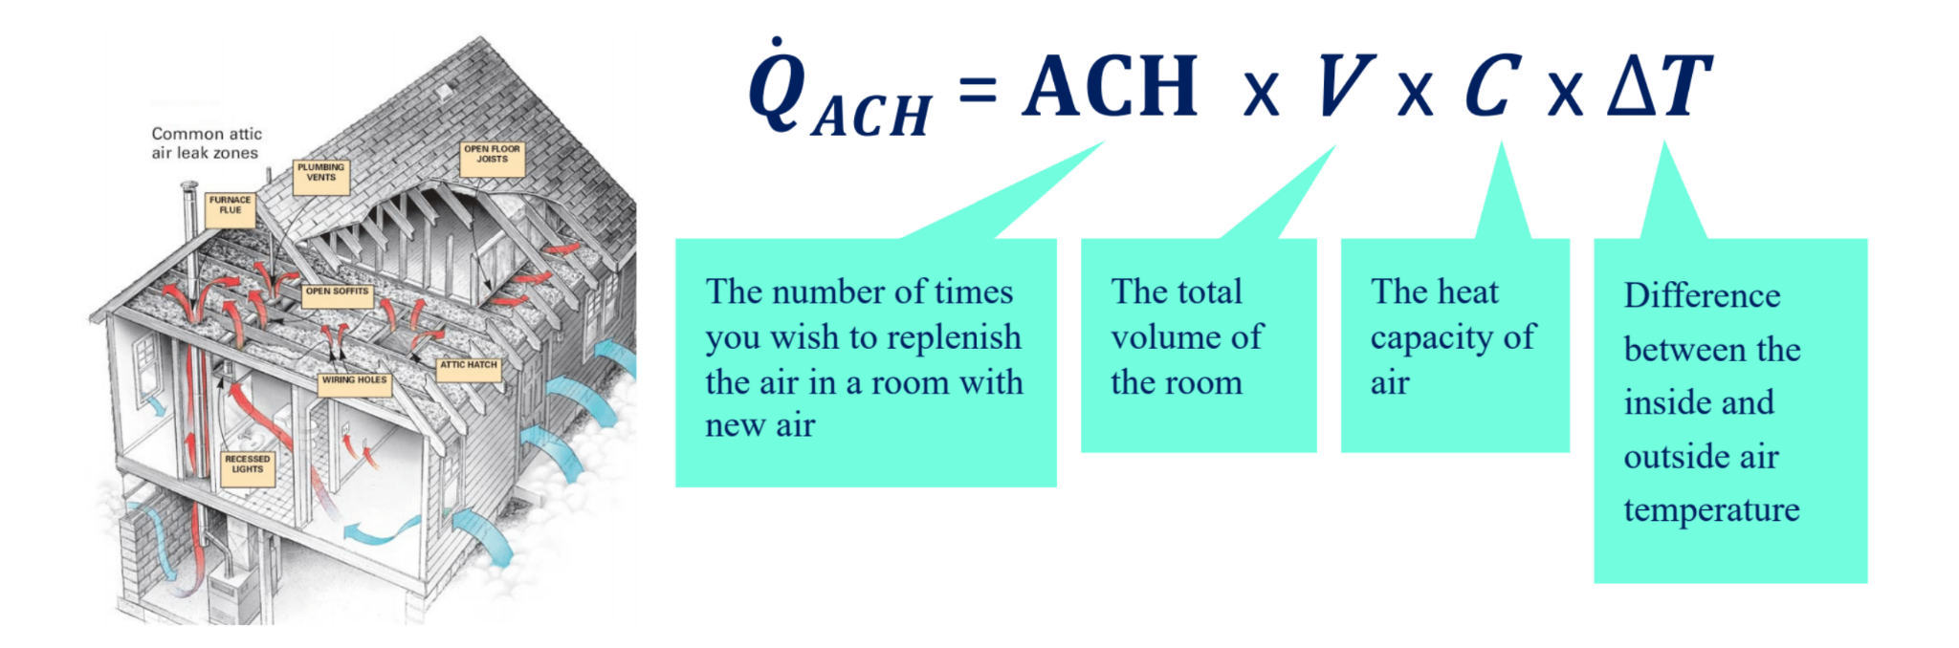
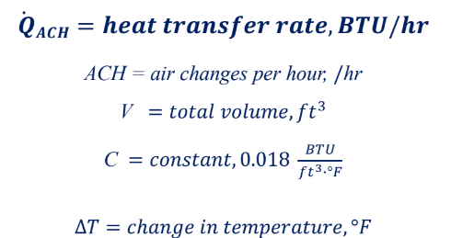
Calculating Loads - Infiltration/Ventilation
Notes:
Explain that Pacific Northwest National Lab (PNNL) conducted an extensive application of BRT, together with measurement and verification.
Emphasize the potential savings, and that these savings are based on applying BRT measures to the majority of building systems.

Slide 40
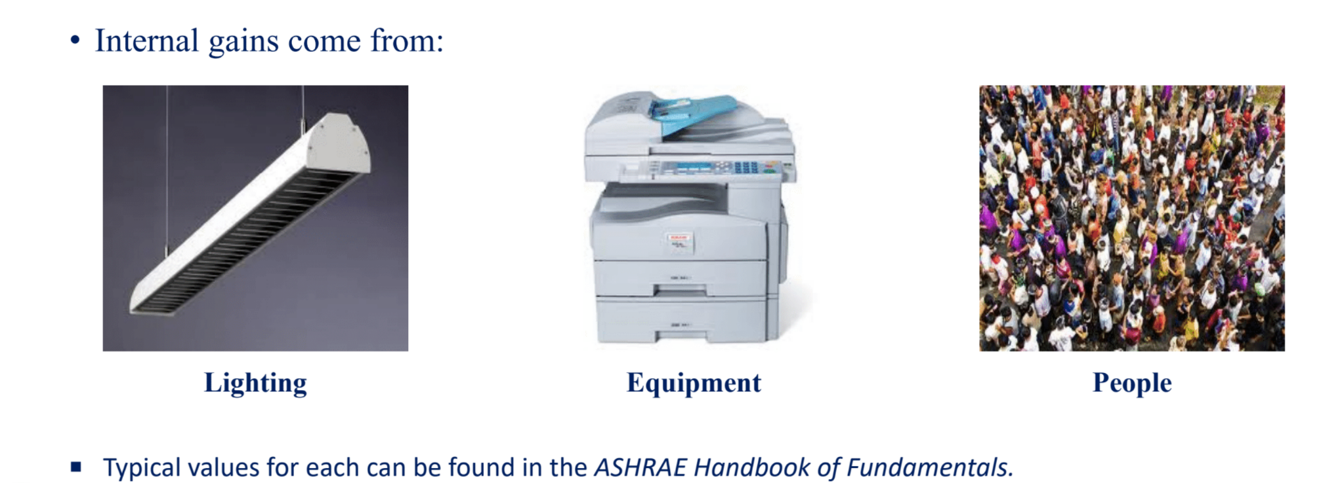
Calculating Loads - Internal Gain
Notes:
Explain that Pacific Northwest National Lab (PNNL) conducted an extensive application of BRT, together with measurement and verification.
Emphasize the potential savings, and that these savings are based on applying BRT measures to the majority of building systems.

Slide 41
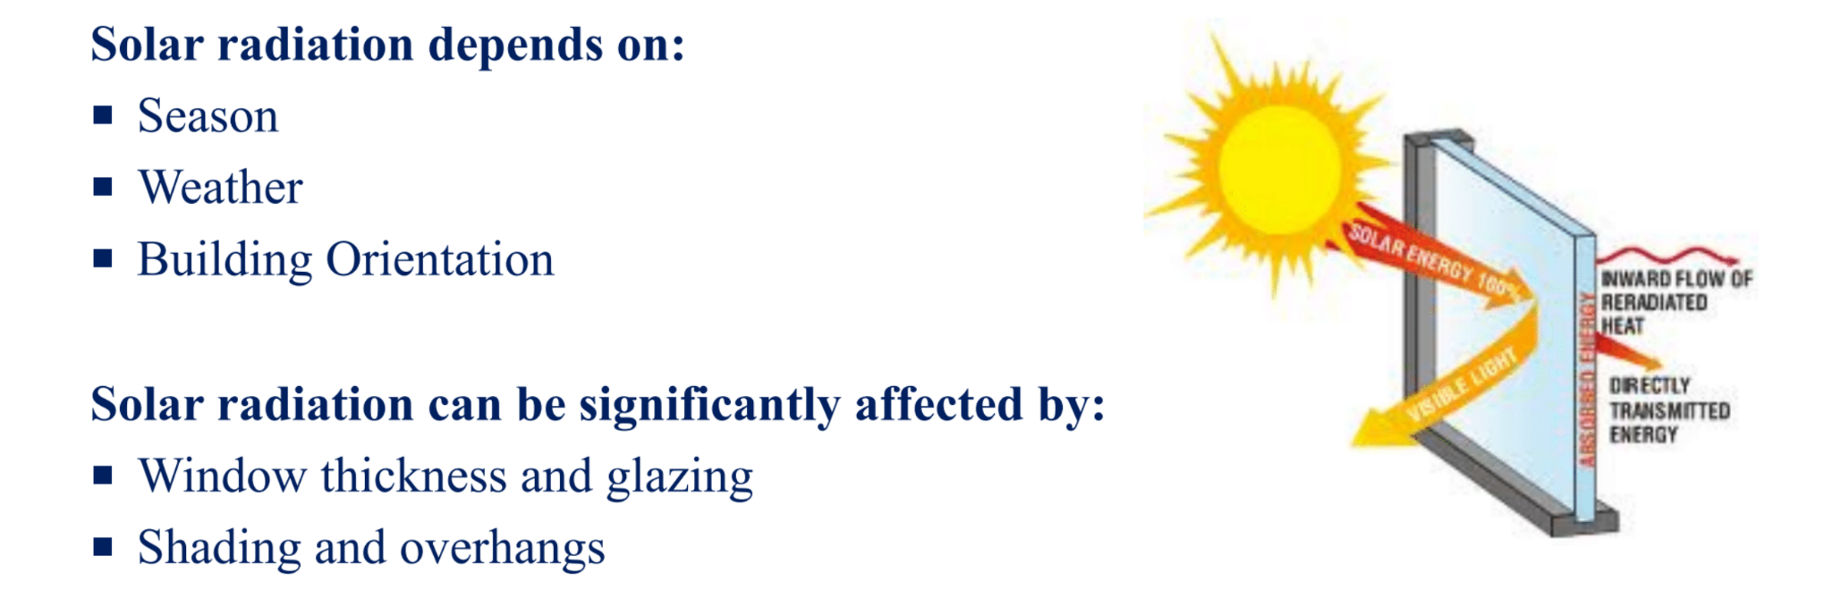
Calculating Loads - Solar Gain
Notes:
Explain that Pacific Northwest National Lab (PNNL) conducted an extensive application of BRT, together with measurement and verification.
Emphasize the potential savings, and that these savings are based on applying BRT measures to the majority of building systems.

Slide 42
Calculating Loads - PROBLEM
Reminder of how to calculate the HEATING LOAD
  Q = Conduction Loss + Infiltration/Ventilation + (- Internal Gain - Solar Gain)
  Q = (U*A*ΔT) + (ACH*V*C*ΔT), where C = 0.018 BTU/ft^3*°F
Assuming that the internal and solar gain are negligible, calculate the heating load of a space with the following characteristics when it is 10°F outside and 70°F inside:
  overall U-value of 0.3 BTU/ft^2*°F*hr
  total surface area of 20,000 ft^2
  total volume of 300,000 ft^3
  ventilation provides 1 ACH
Notes:
Explain that Pacific Northwest National Lab (PNNL) conducted an extensive application of BRT, together with measurement and verification.
Emphasize the potential savings, and that these savings are based on applying BRT measures to the majority of building systems.

Slide 43
Calculating Loads - ANSWER
Calculating the HEATING LOAD
  Q = Conduction Loss + Infiltration/Ventilation + (- Internal Gain - Solar Gain)
  Q = (U*A*ΔT) + (ACH*V*C*ΔT), where C = 0.018 BTU/ft^3*°F
  Q = (U*A*ΔT) + (ACH*V*C*ΔT)
  Q = (0.3*20,000*(70-10)) + (1*300,000*0.018*(70-10))
  Q = 684,000 BTU = 684 kBTU
Notes:
Explain that Pacific Northwest National Lab (PNNL) conducted an extensive application of BRT, together with measurement and verification.
Emphasize the potential savings, and that these savings are based on applying BRT measures to the majority of building systems.

Slide 44
Calculating Loads - ANSWER
Calculating the HEATING LOAD
  Q = Conduction Loss + Infiltration/Ventilation + (- Internal Gain - Solar Gain)
  Q = (U*A*ΔT) + (ACH*V*C*ΔT), where C = 0.018 BTU/ft^3*°F
  Q = (U*A*ΔT) + (ACH*V*C*ΔT)
  Q = (0.3*20,000*(70-10)) + (1*300,000*0.018*(70-10))
  Q = 684,000 BTUH = 684 kBTUH (note: this is required input per hour)
This heating load is used to choose the type and size of heating equipment, ie. boiler, pumps, coils, etc.
Notes:
Explain that Pacific Northwest National Lab (PNNL) conducted an extensive application of BRT, together with measurement and verification.
Emphasize the potential savings, and that these savings are based on applying BRT measures to the majority of building systems.

Slide 45
Selecting equipment to the design load
We select the HVAC equipment to the worst case condition but operate it most of the time at part-load. This introduces inefficiencies, which can be greater or less depending on how could a job we do at controlling equipment.
Notes:
Explain that Pacific Northwest National Lab (PNNL) conducted an extensive application of BRT, together with measurement and verification.
Emphasize the potential savings, and that these savings are based on applying BRT measures to the majority of building systems.

Slide 46
So we can consider that Building Performance Science kicks-in, to reduce energy use and carbon emissions, in two ways -
Designing new buildings and retrofits to reduce loads
Operating our equipment more efficiently at the inevitable part-load operating conditions.
Notes:
Emphasize the criticality of students developing this skill, as it is central to identifying inefficiencies and determining what actions might be taken.

Slide 47
Module Break
We’ll learn more about BPS in the next session.
FOR NEXT TIME, watch this video on the basics of HVAC: https://youtu.be/klggop60vlM

Slide 48
Module Break
Answer this question in a 1-2 page essay:
What is the relationship between city and state policy goals around energy and carbon and the role of building technologies and the engineering community?

Slide 50
NYC Sustainable Buildings
Module 2
CUNY Institute for Urban Systems
Building Performance Lab
For matriculated students of the City College of New York
Supported by NYSERDA’s REV Campus Challenge

Slide 51
Learning Objectives
At the end of this lesson students will be able to:
understand the energy management process as an organizational issue
identify ways to optimize energy efficiency using building re-tuning techniques
dissect the control loops involved in operating HVAC systems
Notes:
Say: Review the module objectives

Slide 52
Building Management

Slide 53
Major HVAC Equipment
Central Plant
  Boiler
  Chiller (+Cooling Tower)
Distribution
  Pumps and Fans
  Air-Handling Units
  Terminal Units
Reminder!
Helpful Resource: https://youtu.be/1cvFlBLo4u0
Notes:
Explain that Pacific Northwest National Lab (PNNL) conducted an extensive application of BRT, together with measurement and verification.
Emphasize the potential savings, and that these savings are based on applying BRT measures to the majority of building systems.

Slide 54
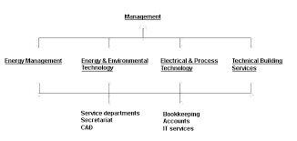
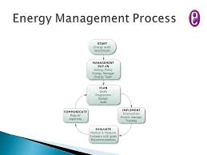
How is all this operated and coordinated?
The complex systems of a building and their performance are managed by a team of people that includes building managers, back-office administrative staff, front-line building operators, and specialist service contractors. Higher level executives relate to government around policy goals and project incentives.
Helpful Resource: https://youtu.be/uXG1y2bOufo
Notes:
Explain that Pacific Northwest National Lab (PNNL) conducted an extensive application of BRT, together with measurement and verification.
Emphasize the potential savings, and that these savings are based on applying BRT measures to the majority of building systems.

Slide 55
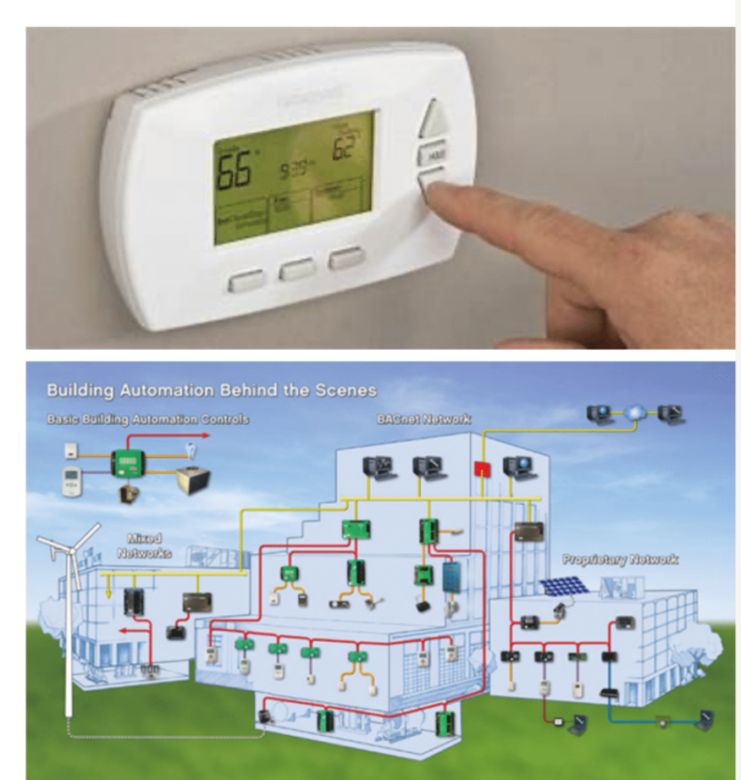
How is all this operated and coordinated?
Controls - Information and Operation
  At its simplest form, a control loop is the manipulation of a “controlled device” in order to achieve the desired value (aka setpoint) for a “controlling parameter”
  Controls can vary from simple thermostats to complex Building Automation Systems
Let’s look at an example →
Helpful Resource: https://youtu.be/uXG1y2bOufo
Notes:
Explain that Pacific Northwest National Lab (PNNL) conducted an extensive application of BRT, together with measurement and verification.
Emphasize the potential savings, and that these savings are based on applying BRT measures to the majority of building systems.

Slide 56
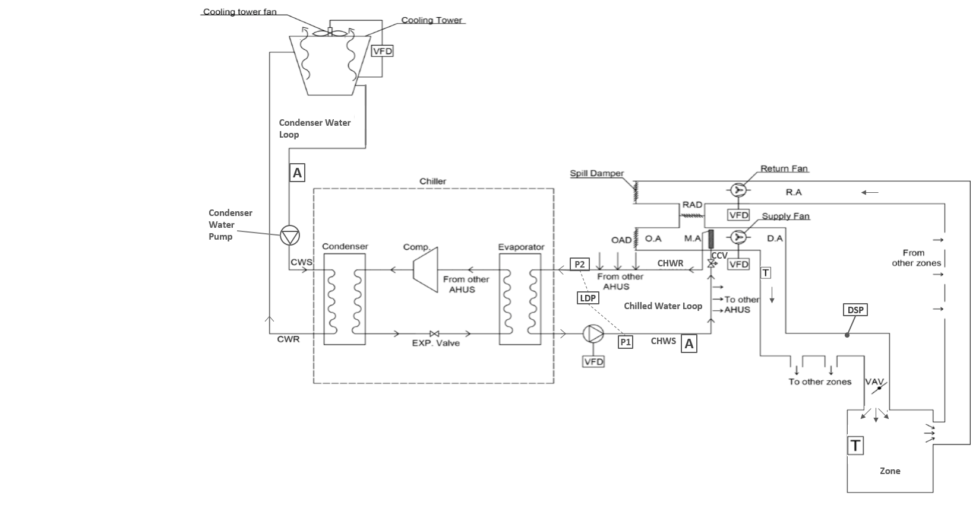
Sample Building Cooling System and Subsystems
COOLING TOWER
AIR-HANDLING UNIT
CHILLER
CHILLED WATER LOOP
CONDENSER WATER LOOP
ZONE

Slide 57
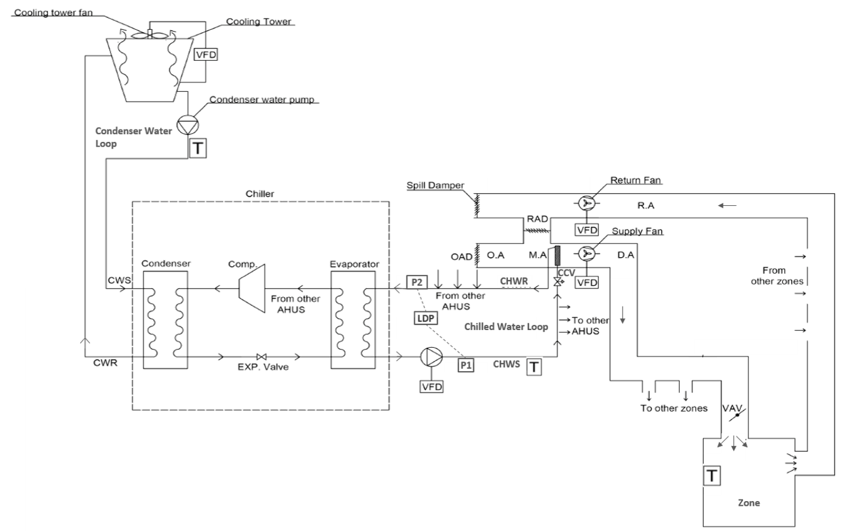

Example Control Loop – Zone Temperature
Controlling Parameter | Controlled Device
LEGEND
VAV | Variable air volume box
 | Thermostat
 | Control loop
Zone Temperature
VAV Damper Position

Slide 58
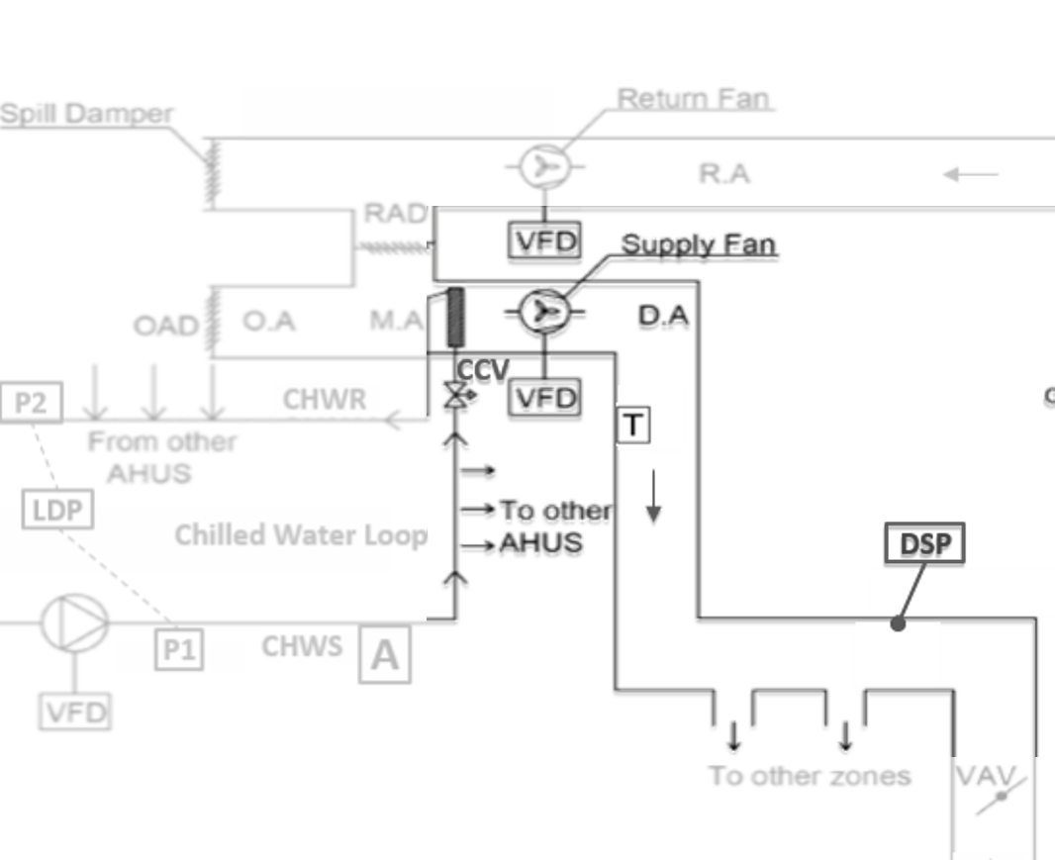
Control Loops in the AHU and Duct Work
LEGEND
AHU | Air Handling Unit
DSP | Duct Static Pressure
CCV | Cooling Coil Valve
 | Thermostat
DA | Discharge Air
VFD | Variable Frequency Drive
 | Control loop
Controlling Parameter | Controlled Device
Duct Static Pressure
VFD on
Supply Fan

Slide 59
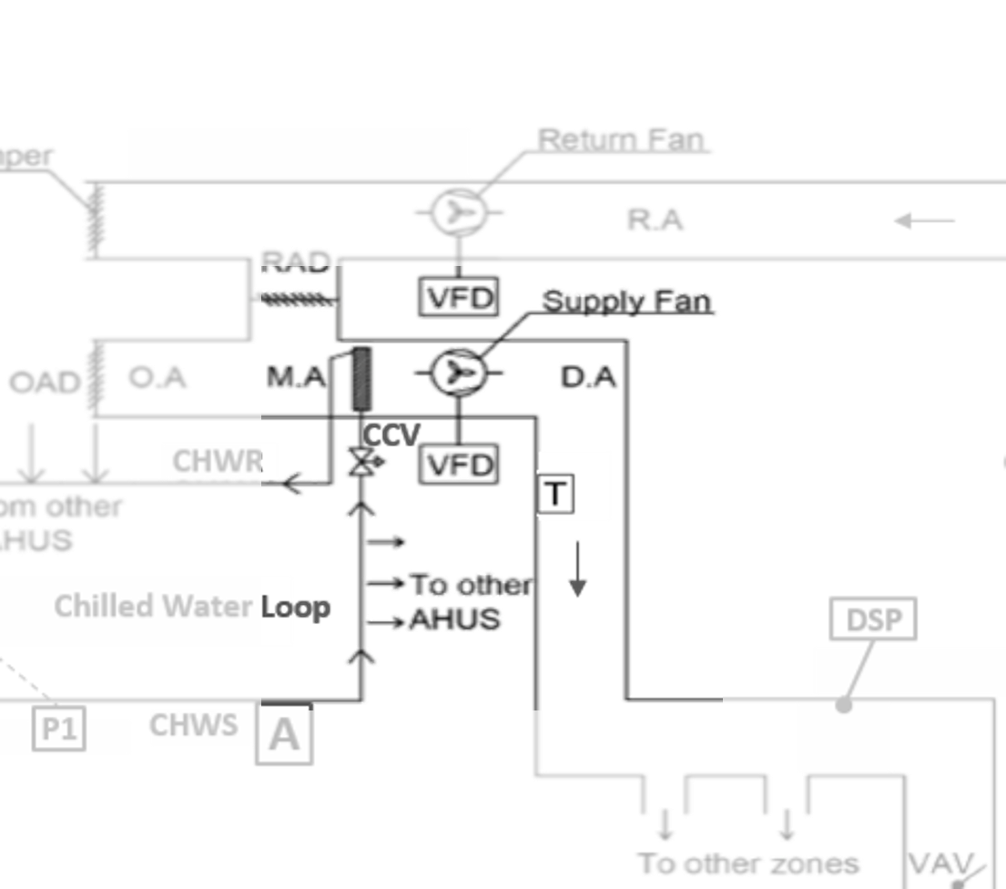
Control Loops in the AHU
LEGEND
AHU | Air Handling Unit
CCV | Cooling Coil Valve
 | Thermostat
DA | Discharge Air
VFD | Variable Frequency Drive
 | Control loop
Controlling Parameter | Controlled Device
Discharge Air Temperature
Cooling Coil Valve

Slide 60
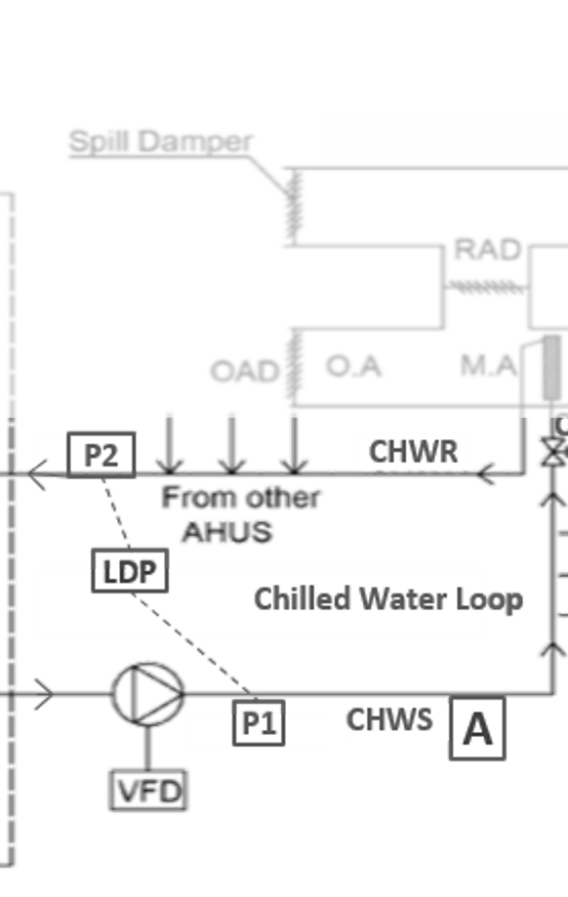
Control Loops in the Chilled Water Loop
LEGEND
CHWR | Chilled Water Return
CHWS | Chilled Water Supply
LDP | Loop Differential Pressure
 | Aquastat
 | Control loop
Controlling Parameter | Controlled Device
Loop Differential Pressure
VFD on Chilled Water Pump
A

Slide 61
Control Loops in the Chiller
LEGEND
CHWR | Chilled Water Return
CHWS | Chilled Water Supply
LDP | Loop Differential Pressure
 | Aquastat
 | Control loop
A
Controlling Parameter | Controlled Device
Chilled Water Supply Temperature
Chiller

Slide 62
Control Loops in the Condenser Water Loop
LEGEND
 | Aquastat
 | Control loop
A
Controlling Parameter | Controlled Device
Condenser Water Supply Temperature
VFD on cooling tower fan(s)

Slide 63
Where Does the Heat Go?
Notes:
Say: Where does the heat go?
Instructor Note: Explain one animation at a time.

Slide 64
Where is the Energy Used?
Notes:
Say: Where is the energy?
Answer: Fan motors (AHU supply fans, return fans, cooling tower fans), pump motors (chilled water, condenser water), and chiller.
Instructor Note: Explain one animation at a time.

Slide 65
Energy Management

Slide 66
HVAC Energy Measures
Addressing HVAC issues have different levels of cost:
Operational changes by building engineer
  Reset temperature setpoints
  Scheduling, staging, varying fan/pump speeds
Small, low-cost upgrades
  Sensor calibration/replacement
  Repair controls/programming (under service contract)
Large, funded projects
  Add insulation/weatherization
  Central plant energy-efficient replacements
Notes:
Explain that Pacific Northwest National Lab (PNNL) conducted an extensive application of BRT, together with measurement and verification.
Emphasize the potential savings, and that these savings are based on applying BRT measures to the majority of building systems.

Slide 67
The Building Performance Lab focuses on utilizing no/low-cost measures to improve energy efficiency in building operations. One of their programs uses Building Re-tuning, a type of ongoing commissioning, to get this done.
Notes:
Emphasize the criticality of students developing this skill, as it is central to identifying inefficiencies and determining what actions might be taken.

Slide 68
The Awesome Power of the “Affinity Laws”
Affinity laws (sometimes called “fan laws” or “pump laws”) are:
Flow is proportional to the shaft speed
Pressure is proportional to the square of the shaft speed
Power is proportional to the cube of the shaft speed
This gives you a payback for every fan and pump you have on a VFD that modulates; let’s do an example…

Slide 69
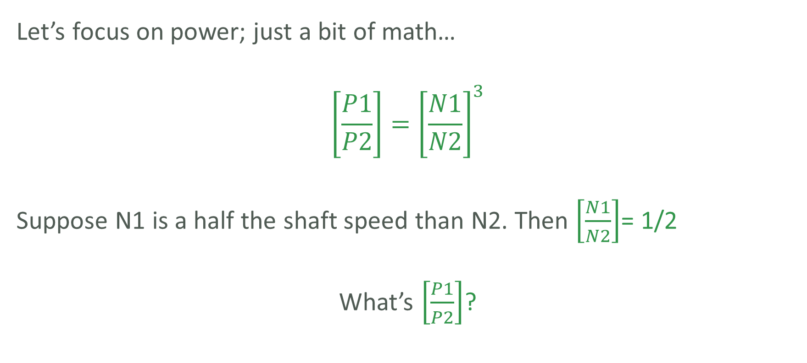
The Awesome Power of the “Affinity Laws”
Notes:
Say:
Set up the problem for them. Pause to give them a chance to work it out on their own.

Slide 70
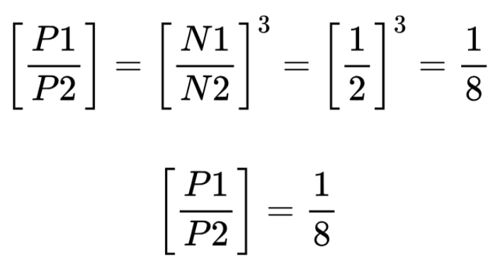
The Awesome Power of the “Affinity Laws”
So if you reduce your motor speed by ½, you reduce your power by ⅞ - about (88%)!
Notes:
Say:
Give them the answer and emphasize how effective using VFDs can be.

Slide 71
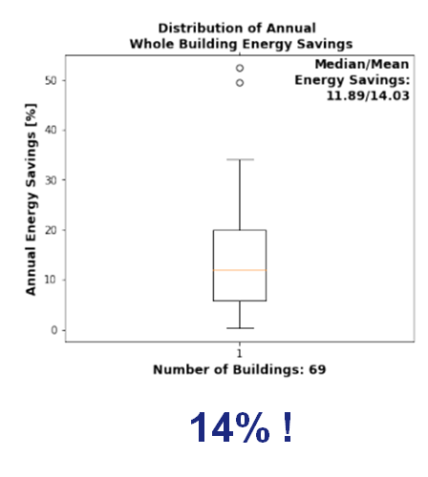

The Potential of Building Re-tuning
A recent program led by the Pacific Northwest National Lab (PNNL) applied BRT to 69 buildings of differing use and location.
The average whole building energy savings were 14.03%
Source: Srinivas Katipamula, “Improving Commercial Building Operations
through Building Re-tuning: Meta-Analysis”, PNNL
Notes:
Explain that Pacific Northwest National Lab (PNNL) conducted an extensive application of BRT, together with measurement and verification.
Emphasize the potential savings, and that these savings are based on applying BRT measures to the majority of building systems.

Slide 72
Module End
Any questions?
A thank you to NYSERDA’s REV Campus Challenge for sponsoring this set of modules.

Slide 73
Additional Modules
Building Automation System Basics
for comp/mech/elec engineering, architecture majors
Use Niagara board for input/controls
Use SAMS for output/design
Energy Data Visualization for FDD
for engineering, comp sci, design majors
Building re-tuning
Interval data, real time metering (w/ EnerTrac?)
BAS/noBAS trending
Common LMOs + savings
Building Science Basics
for architecture, physics, engineering majors
Envelope
Ventilation
Heat loss calc
Low energy retrofits, passive house
Building systems, major equipment
Advanced tech: CHP, heat pumps, PV
Energy Laws and Benchmarking
for social science, environmental science majors
NYC & NYS Energy Goals and Policies
NYC Green Building and Carbon Cap Laws
Focus on buildings. Pathway to 80x50
EUI + Benchmarking (w/ EPA portfolio manager)
Common ECMs + savings
Energy Units and Conversions
Notes:
Explain that Pacific Northwest National Lab (PNNL) conducted an extensive application of BRT, together with measurement and verification.
Emphasize the potential savings, and that these savings are based on applying BRT measures to the majority of building systems.

